Slide 1
AI Fundamentals

Slide 2
Contents
What is intelligence?
What is artificial intelligence?
Examples of AI:
  Linear and non-linear models
  Deep learning
  Image recognition
TL;DR : AI is automated pattern recognition

Slide 3
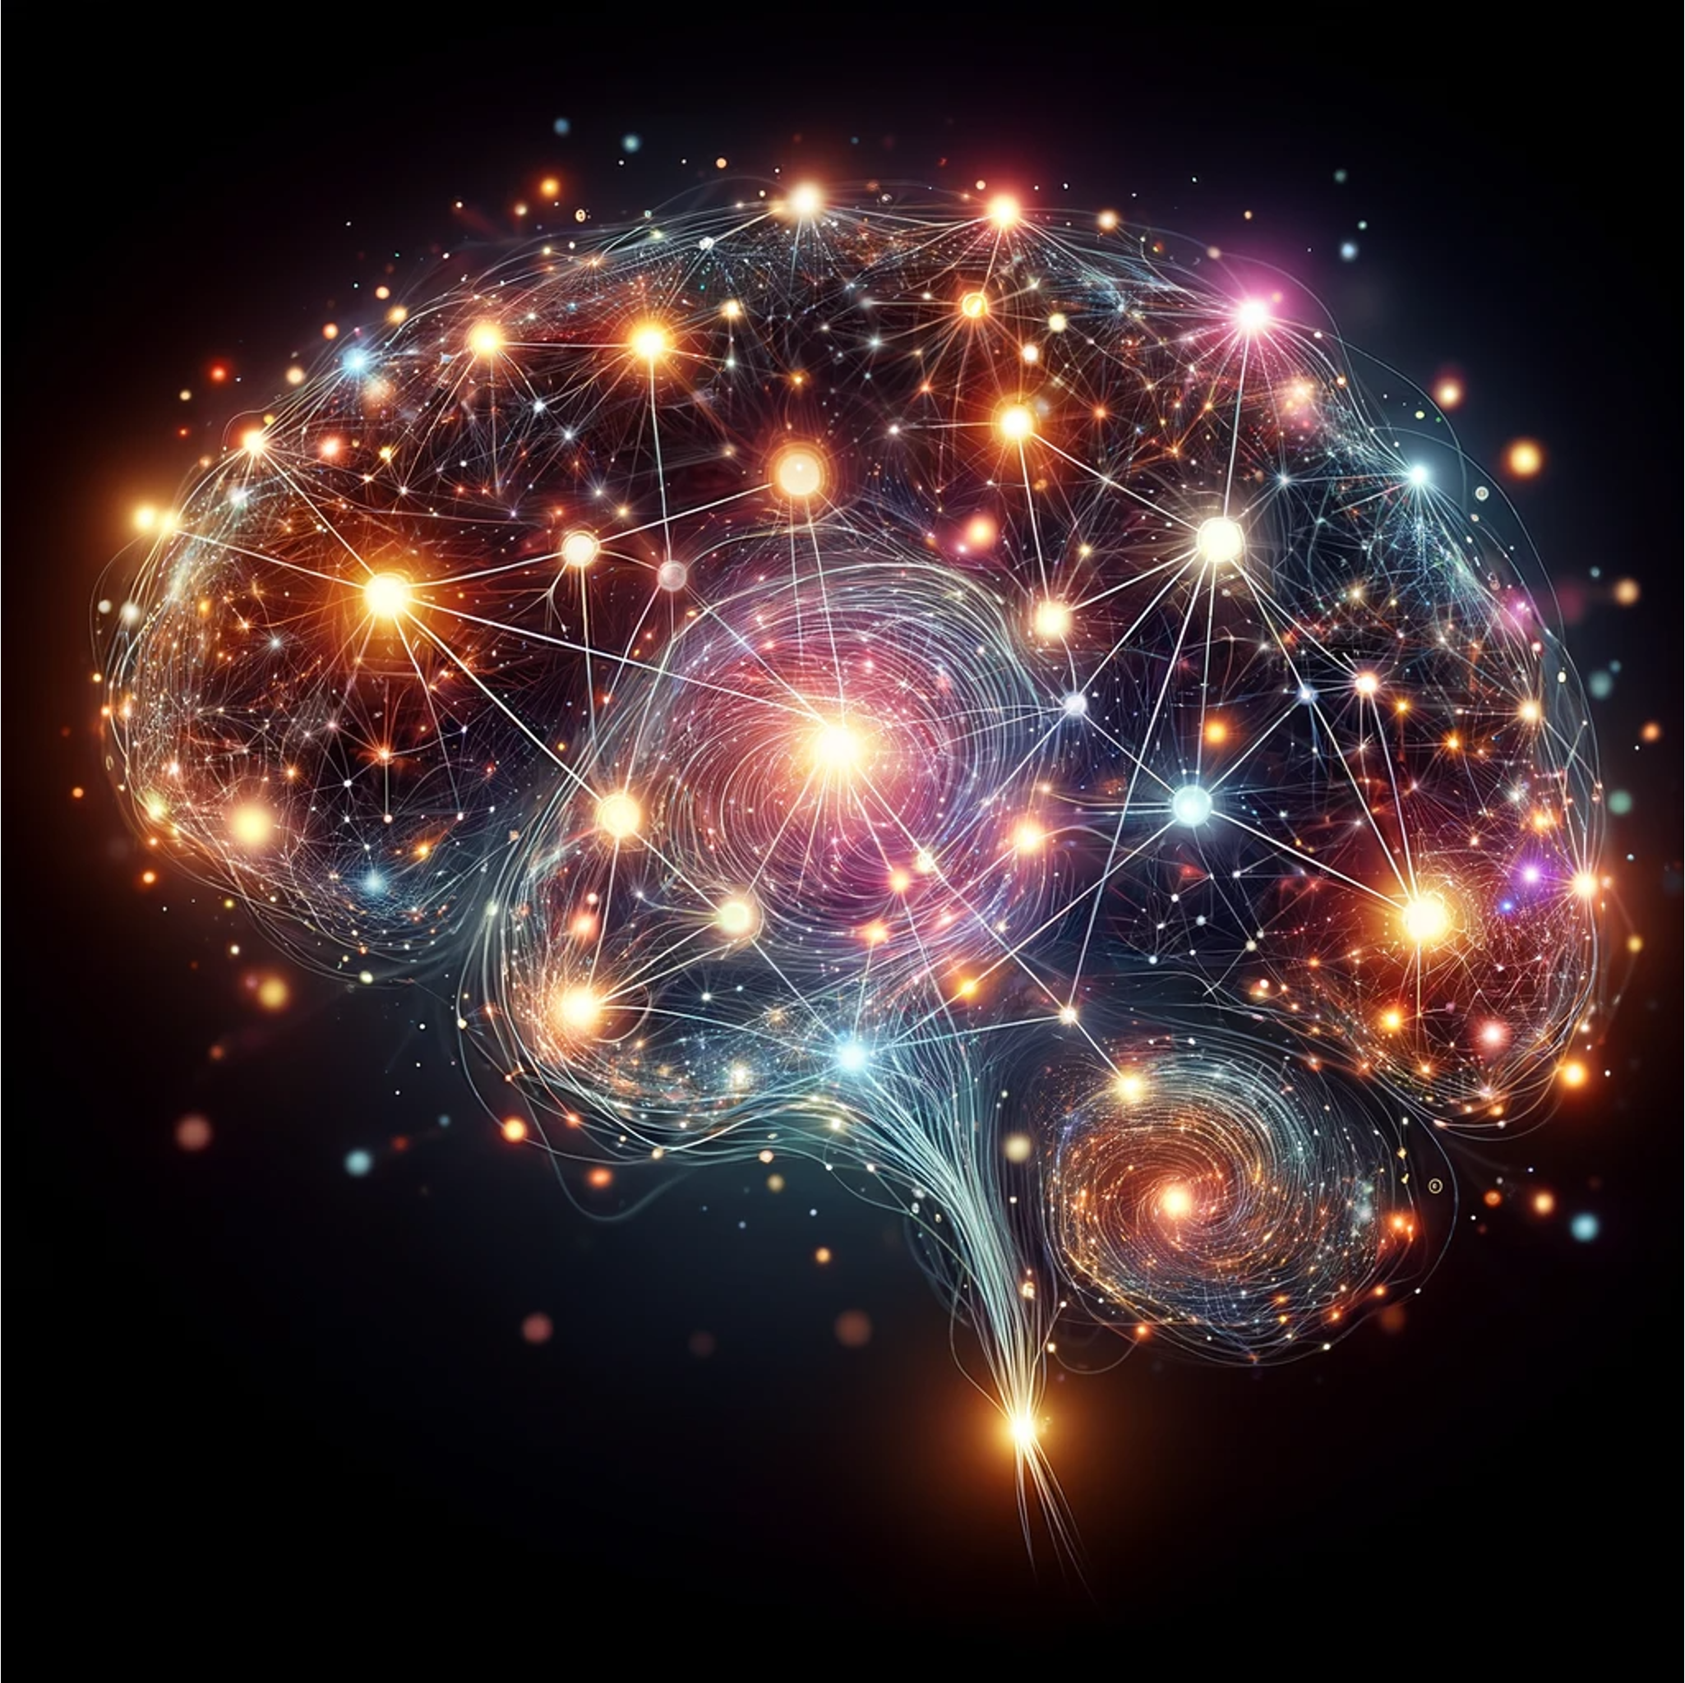
What is intelligence?
Intelligence: probably something in the brain
Brain: machine that receives input and produces output
Inputs and outputs: electrical impulses running on biological processes.
Detecting patterns in electrical impulses: intelligence.

Slide 4
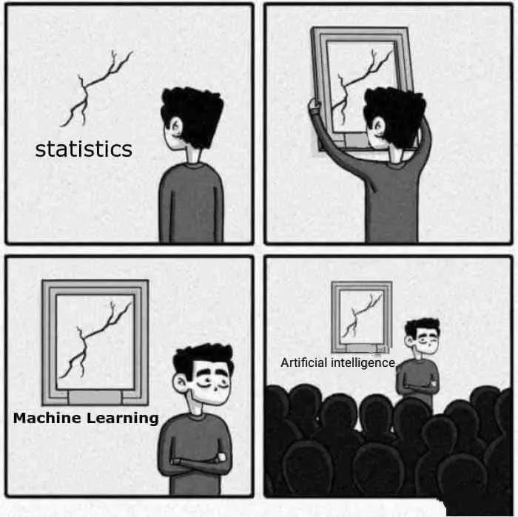
What is AI?
source: https://www.instagram.com/sandserifcomics/

Slide 5
What is AI? No, but really
“AI is that which is not yet possible”:
  Playing chess (solved in 1990s)
  Playing go (solved in 2010s)
  Image recognition (solved in 2010s)
  Self-driving cars (80% done in 2025)
  Speech recognition (90% ? done in 2025)
  Producing coherent language (done in 2025)
These are all examples of pattern recognition.

Slide 6
The history of computers: TL;DR version
What can be done with computers in:
1940s – 1950s: math
1960s – 1950s: store data
1980s – 1990s: automate business processes
2000s – 2010s: automate industrial processes
1990s – now: pattern recognition (see next slide)

Slide 7
The history of pattern recognition in computing
Hamming, 1997: “The next big area [in computing] is, I believe, pattern recognition.”
1990 – 2010: statistical foundations
  “When we say ’AI’ we mean: ‘lookup table’’.
2012: deep learning
  Computers determine connections between inputs
2017: transformers
  Deep learning, treating connections as vectors (see next slide)
2023: chatGPT4
  Language model based (probably) on transformers

Slide 8
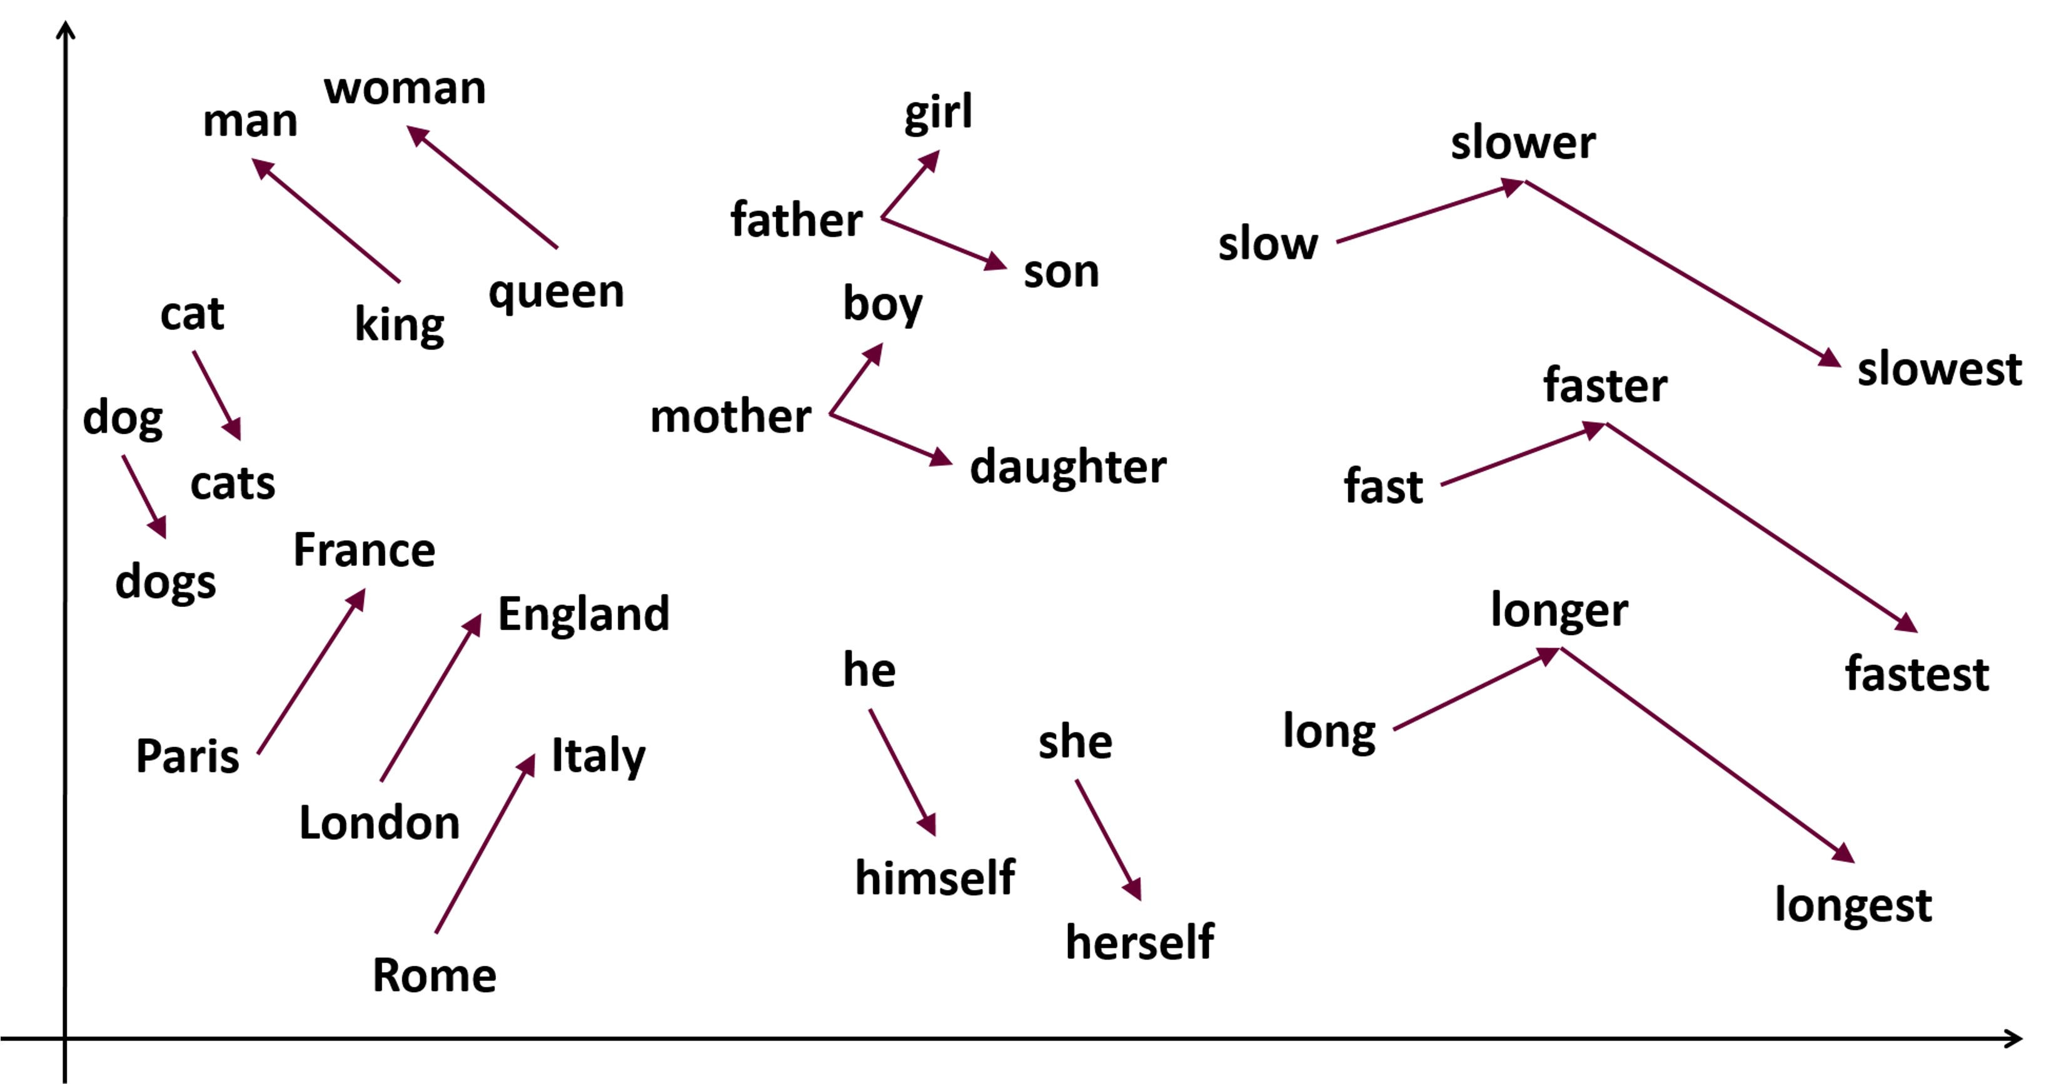
Connections between inputs as vectors
So-called “vector databases” store these connections (vectors) as sets of numbers

Slide 9
Other types of patterns
Linear models
Non-linear models
Deep learning
Image recognition

Slide 10
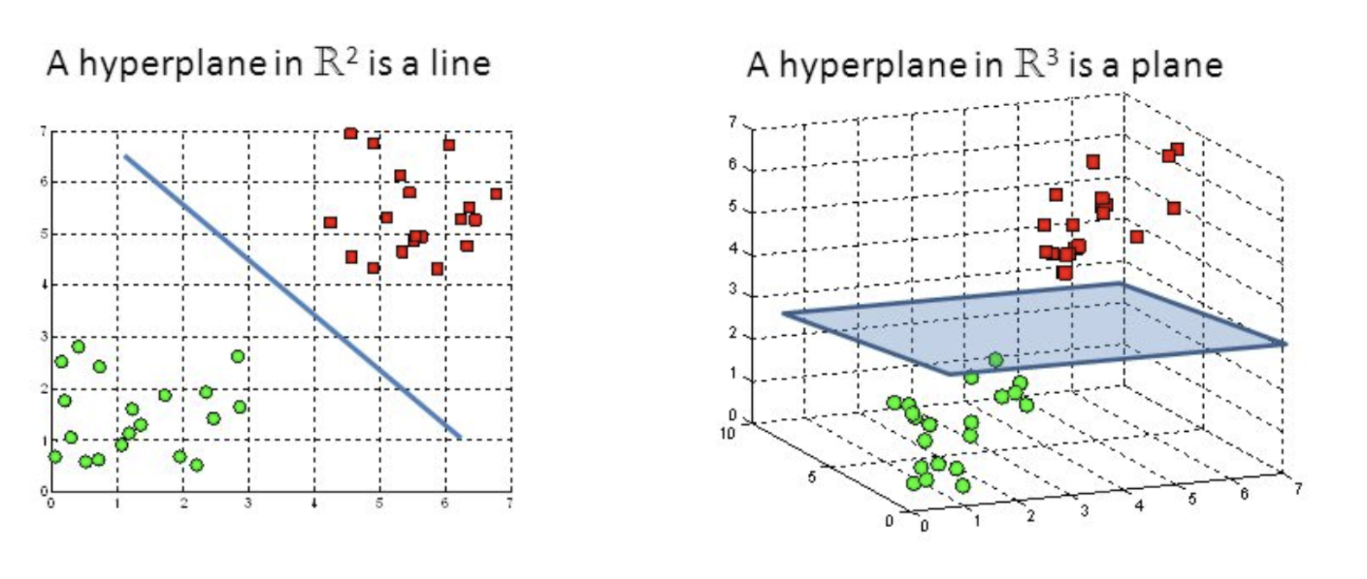
Linear models
Linear models can be used for classification (as in the images below) or for “regression”: predicting a specific output given a specific input).
Linear models can have more than two dimensions!
A linear model is called a “hyperplane”: a plane with one dimension less than the number of variables.
For classification, the hyperplane should separate classes. For regression, points should be as close as possible to the hyperplane.

Slide 11
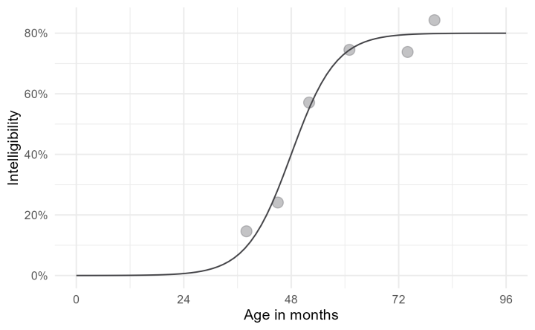
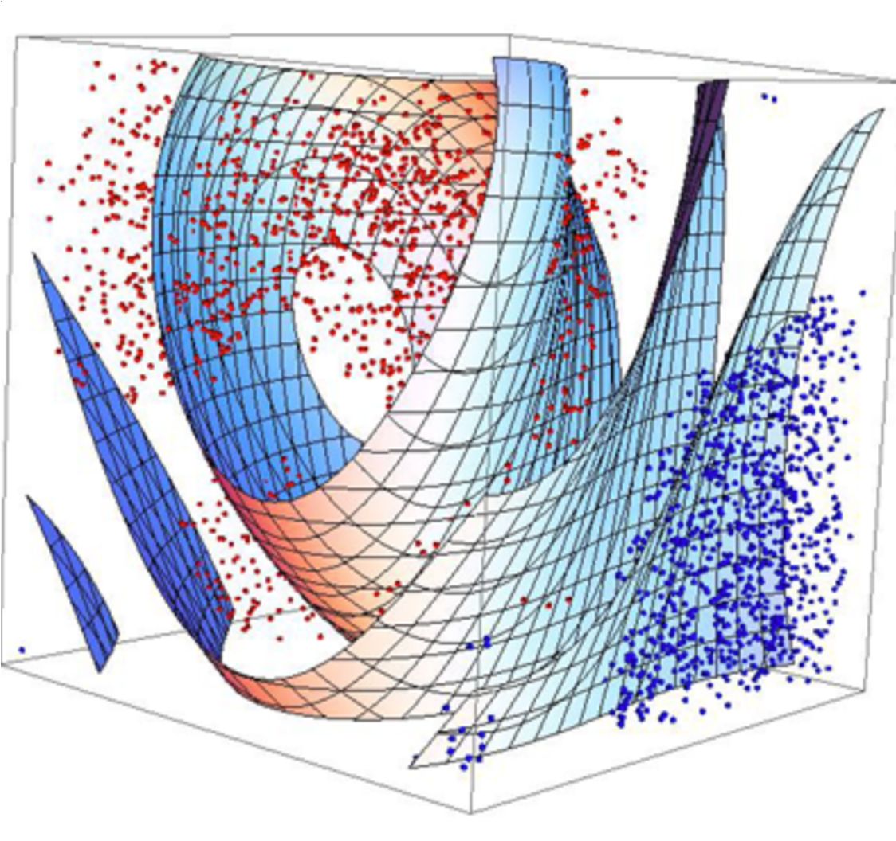

Non-linear models
Many things in the real world are linear, but many things are not.
Example: logistic curve plotting intelligibility of a child’s speech against its age in months.
Formula is: $f\left(t\right)= \frac{asymptote}{1+exp⁡(\left(mid −t\right)∗scale}$
Much more complicated formulas are possible.
source: https://r-craft.org/anatomy-of-a-logistic-growth-curve/

Slide 12
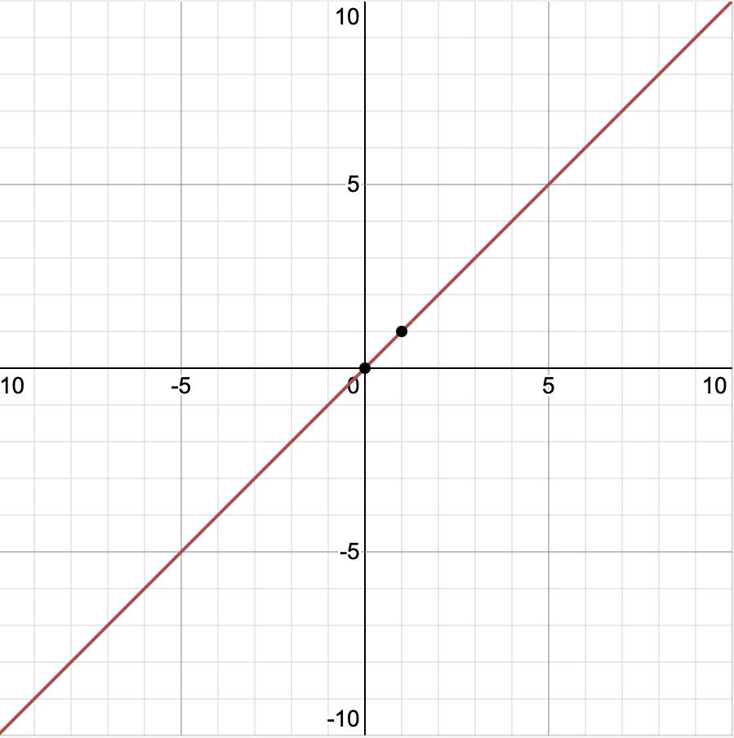
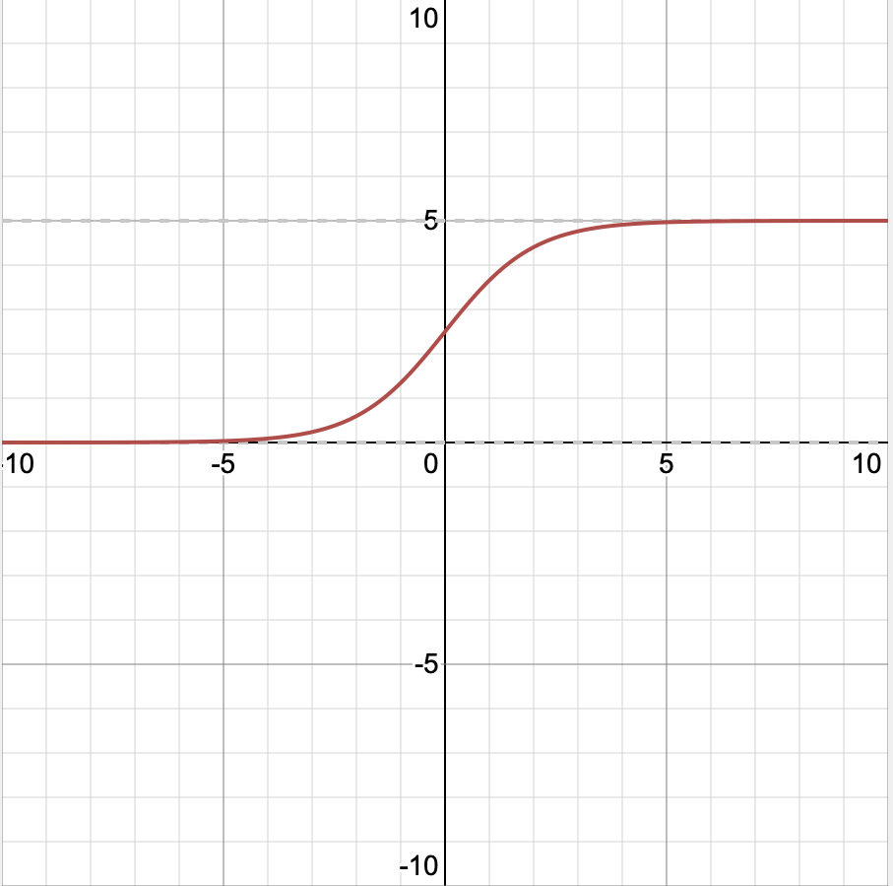
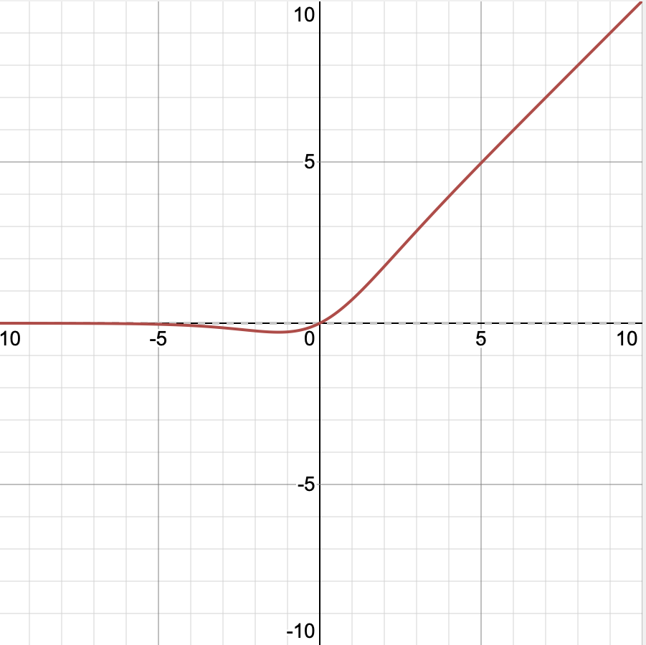
Deep learning: neural networks (1)
Many non-linear models can not be captured using “simple” formulas like the one in the previous sheet.
These require combinations of functions (formulas).
Such combinations are called “neural networks”. They were invented in the 1940s.
The smallest possible neural network is a combination of one “regular” function and one so-called “activation function”.
+
=
f(x) = x
g(x) = 1/(1 + e^{-x})
f(g(x))

Slide 13
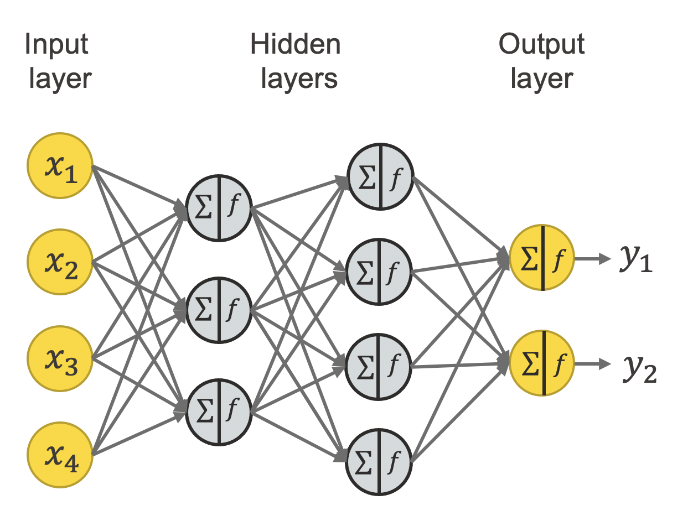
Deep learning: neural networks (2)
In practice, neural networks are a bit more complicated than “function going into activation function”.
It turns out networks of functions are easier to train.
Such networks often stack functions in layers.
Because a lot of work is done inside layers, the learning is said to be “deep”: Deep Learning

Slide 14
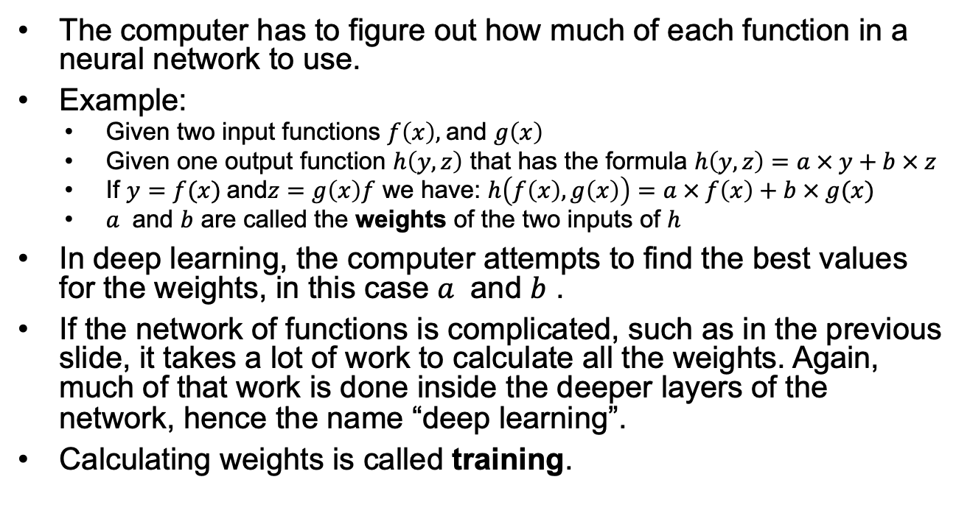
What makes deep learning “learning”?
The computer has to figure out how much of each function in a neural network to use.
Example:
  Given two input functions $f\left(x\right),$and $g\left(x\right)$
  Given one output function $h\left(y, z\right)$ that has the formula $h\left(y, z\right)=a × y+b × z$
  If $y=f(x)$and$z=g\left(x\right)f$ we have: $h\left(f\left(x\right), g\left(x\right)\right)=a × f\left(x\right)+b × g(x)$
  $a$ and $b$ are called the weights of the two inputs of $h$
In deep learning, the computer attempts to find the best values for the weights, in this case $a$ and $b$ .
If the network of functions is complicated, such as in the previous slide, it takes a lot of work to calculate all the weights. Again, much of that work is done inside the deeper layers of the network, hence the name “deep learning”.
Calculating weights is called training.

Slide 15
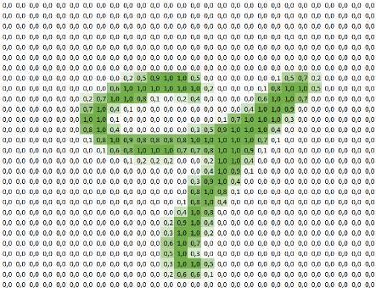
Image recognition (1)
Image recognition is done with networks of functions.
The inputs to this network are the values of each of the pixels of the image.
Images have a lot of pixels, so part of the network serves to summarize groups of pixels.
A function that summarizes groups of pixels is called a convolution (hence: convolution neural network or cnn).
26x26
3x3
24x24
3x3
12x12
3x3
3x3
3x3
4 * 12 * 12 = 576 nodes...
26x26
3x3
24x24
50 nodes
3x3
12x12
3x3
3x3
28x28
3x3
10 nodes
26x26
3x3
24x24
12x12
3x3
3x3
3x3
3x3
26x26
3x3
24x24
3x3
12x12
3x3
3x3
3x3

Slide 16
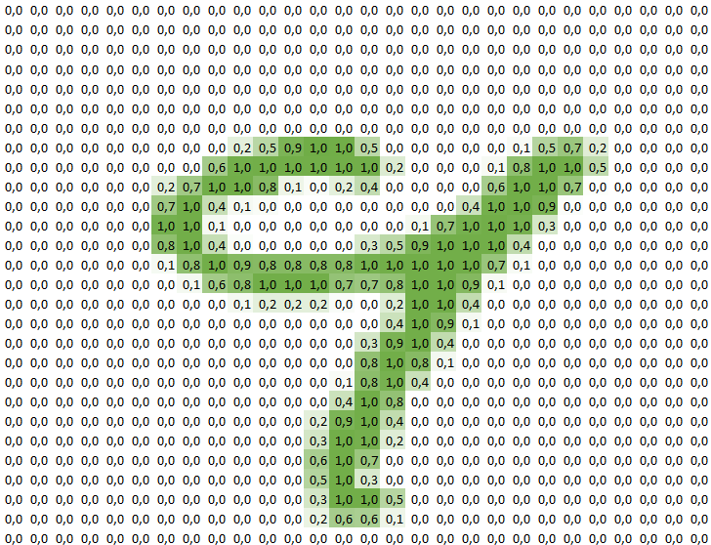
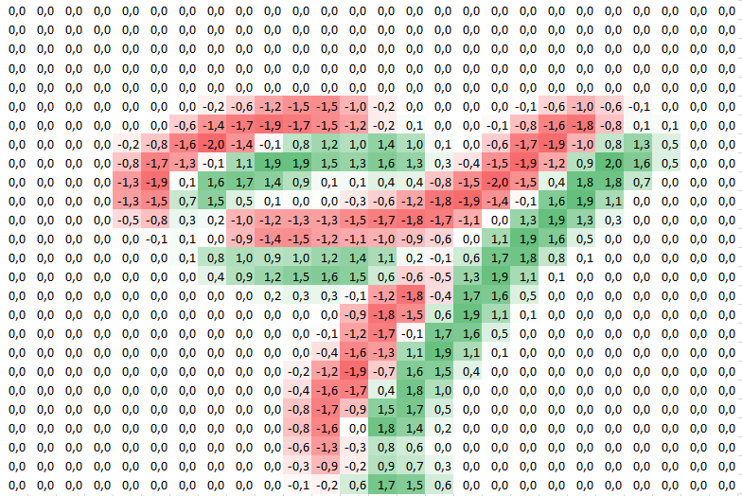
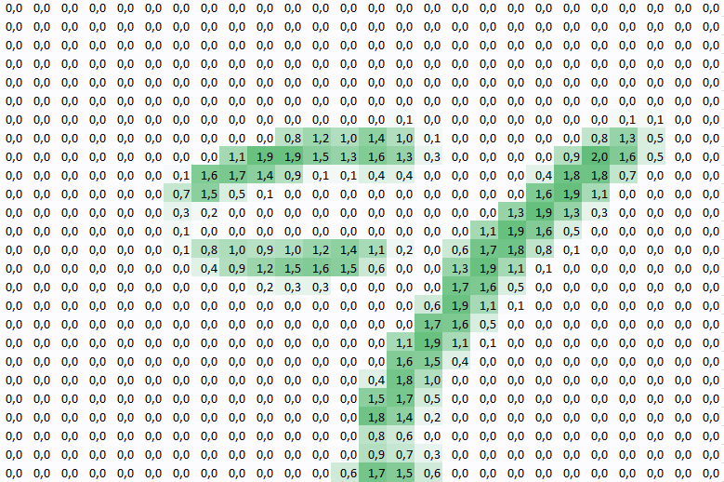
Image recognition (2)
Different layers in a convolution neural network ”see” different types of patterns in images.

Slide 17
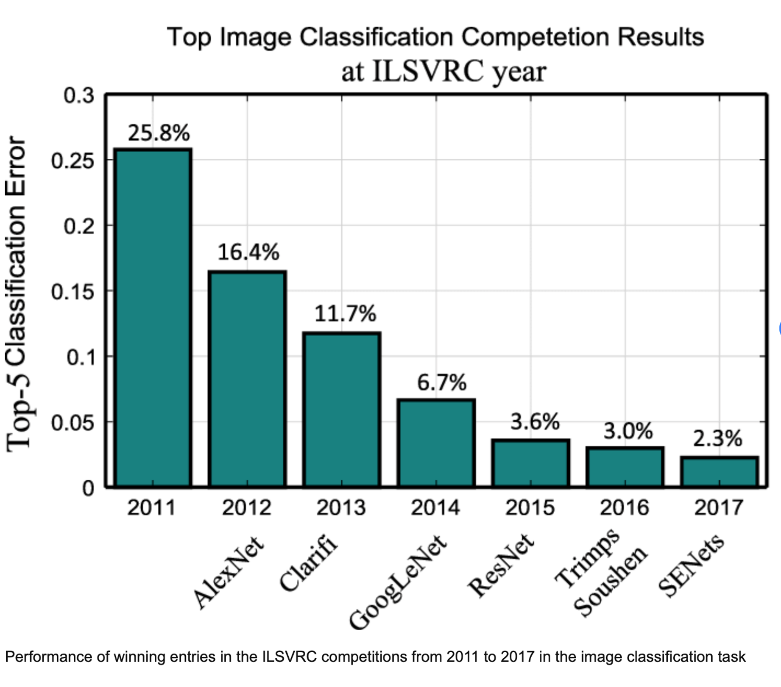
Image recognition (3)
Image recognition is now a solved problem.
Human performance is about 5%

Slide 18
What about language models (ChatGPT, Claude, Etc)?
Recall the slide “connections between inputs as vectors”.
During training weights are calculated for the connections between words or parts of words (“tokens”).
An LLM (Large Language Model) has billions of connections and therefore billions of parameters.
Training data is the entire internet.
When you use an LLM, the model examines the text you wrote and calculates which words / tokens are most likely to be a correct response to it.
This is an oversimplification.
However, an LLM is still nothing more than a tool to find patterns.

Slide 19
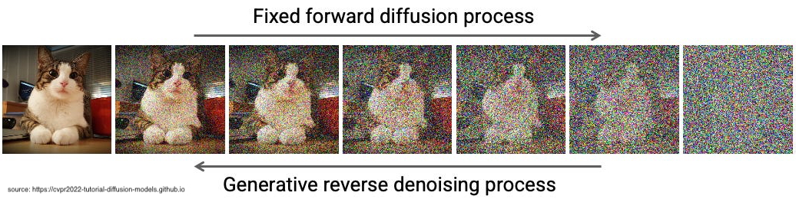
Recent developments
2025: Transformer based LLMs have stopped improving.
New directions:
  Improving efficiency (eg. DeepSeek)
    Allocate different amounts of computing power to different parts of the data.
    Use previously trained but computationally expensive models as input for training.
    Apply good old fashioned code optimization.
  Modeling different aspects of the brain (eg. Hierarchical Reasoning)
    Use two different networks running at different speeds. The slow network supplies the fast network with chunks of training data and processes the results.
  Using more complicated math (eg. Diffusion Models)
    Add noise to an image and then train a model to remove that noise.

Slide 20
Conclusion
AI is the name we give to automated pattern finding.

